Slide 1
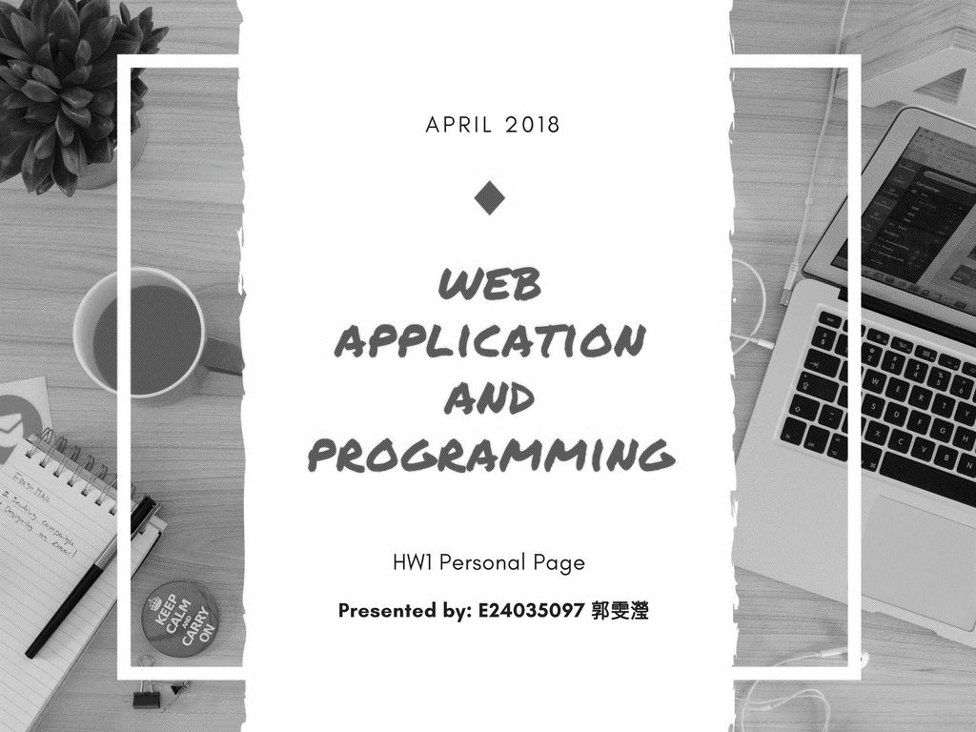
M A Y
HW2 PHOTO GALLERY
http://140.116.245.148/WebCourse/students/e24035097/hw2/index.html
http://140.116.245.148/WebCourse/students/e24035097/hw1/index.html

Slide 2
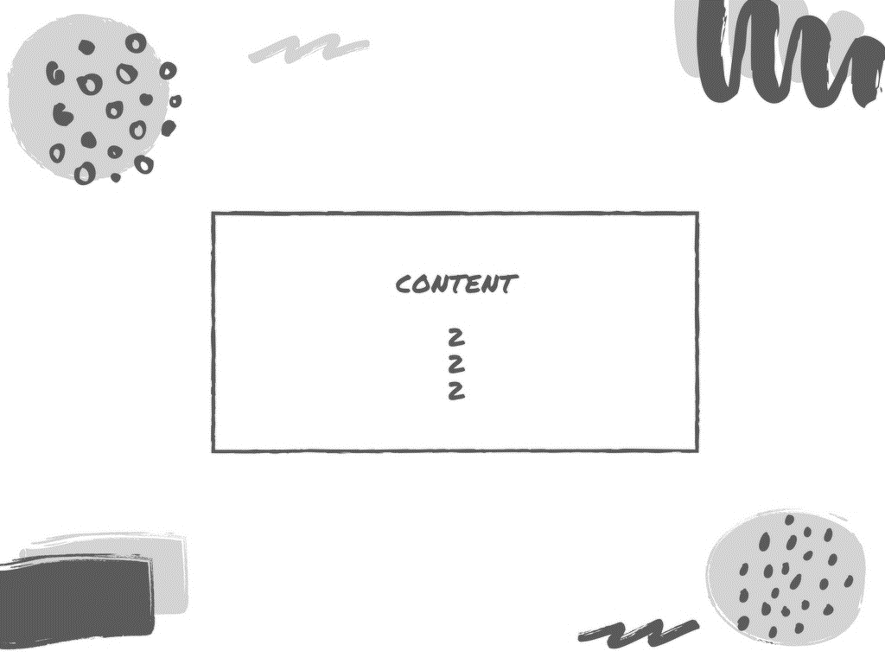
4-7 Web Page Overview
8-12 Web Page Introduction
13-14 Difficulty & Solution

Slide 3
W E B P A G E O V E R V I E W

Slide 4
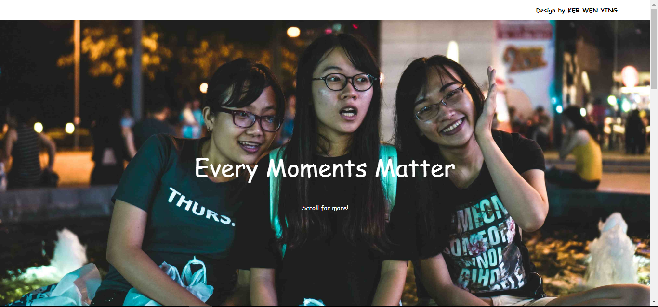
I
N
D
E
X
http://140.116.245.148/WebCourse/students/e24035097/hw2/index.html

Slide 5
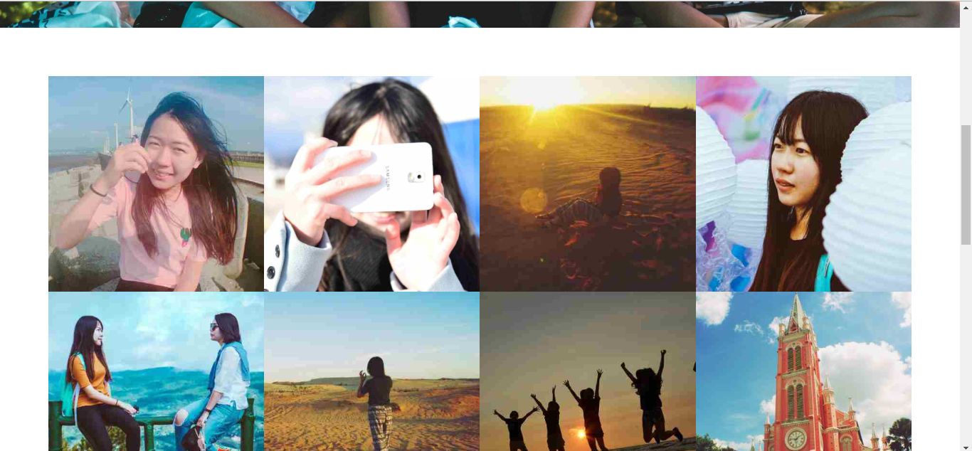
SCROLL
DOWN

Slide 6
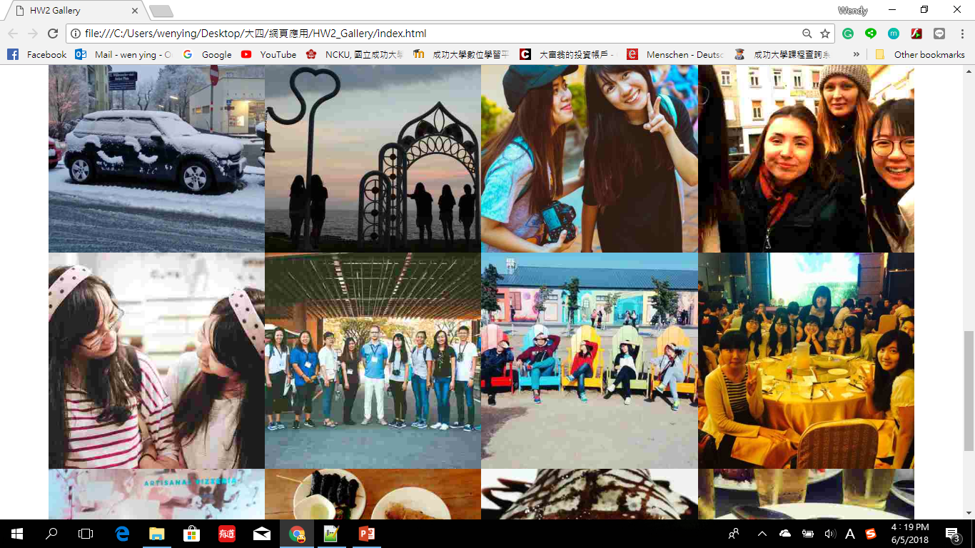
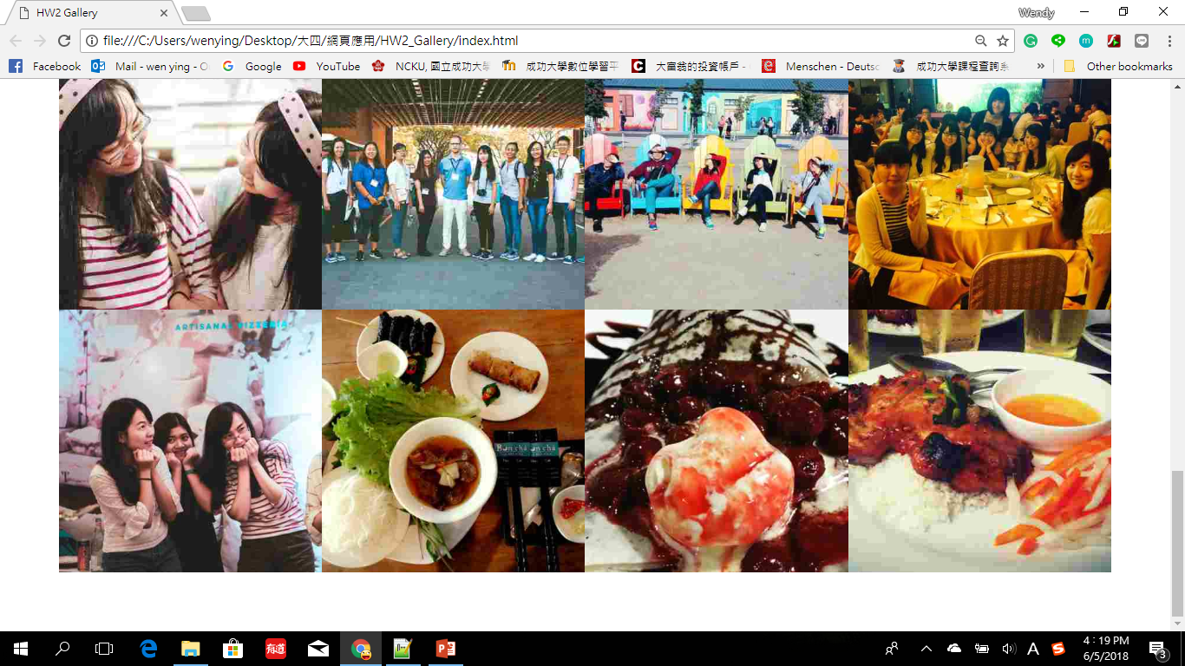

Slide 7
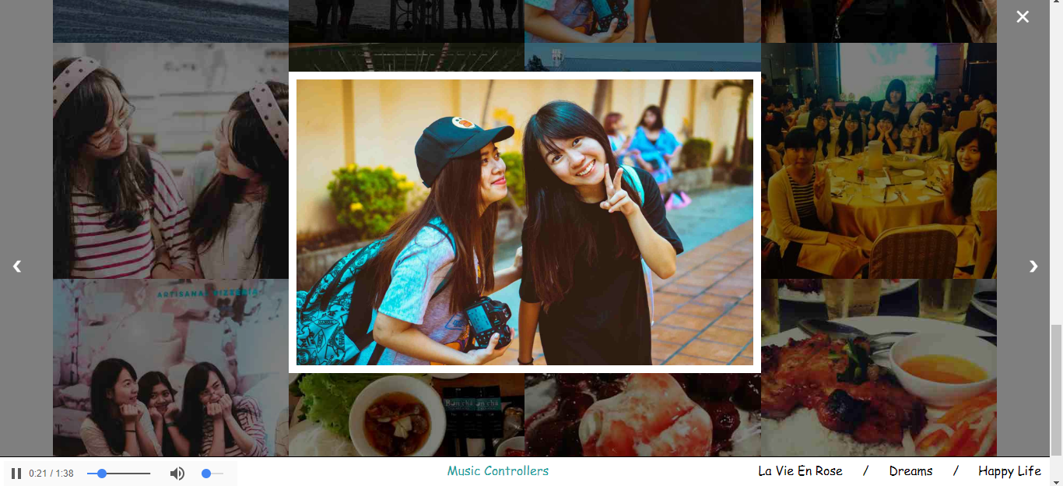
CLICK ON
IMAGE

Slide 8
W E B P A G E I N T R O D U C T I O N

Slide 9
I
N
D
E
X
BAR on The Top
-located on top
-CSS used: overflow, background-color, position, padding, width, float, text-decoration, font-family, z-index
TEXT
-use template of Animation.CSS –animation name: Jello [transform for 8 s]
-CSS used: text-align, position, top, left, transform, animation-name, duration, keyframes
BACKGROUND IMAGE
-CSS Used: background-image, position, repeat, size; height

Slide 10
SCROLL
DOWN
FLEX CONTAINER
-display image preview within this flex container that will wrap
-CSS used: display, flex-wrap, align-items, box-sizing

Slide 11
IMAGE
-when click on it, open the gallery slideshow （have ease in transition）
-hover: scale(1.075)----img will become bigger
-CSS used: object-fit, transform, transition
-HTML used: img, hover,
-JS function: openModal() , closeModal()

Slide 12
CLICK ON
IMAGE
BUTTON
X{CLOSE the slide show}
> {next photo}
< {previous photo}
-JS function: plusSlides()
SLIDESHOW (Manual & Auto)
-you can click on the button for next/previous photo;
or wait for 5s to jump automatic to the next photo
-download the image directly if click on it
-CSS used: cursor, object-fit, overflow, z-index, etc
-HTML used: <a download>
-JS function: currentSlide()
BACKGROUND
-black color with 0.6 opacity
FOOTER(Music Controller)
-music play automotively, have 3 music, after one
end,will continue to the second music
-music will pause if leave the slideshow
-can choose the music as freely as you wish
-HTML used: audio
-JS function: run()

Slide 13
D I F F I C U L T Y
&
S O L U T I O N

Slide 14
照片容量太大，網頁加載很慢
- 把照片畫質減低，減低容量
2. 照片大小不一致，顯示出來的畫面會卡掉
-先把照片的大小透過修圖軟體統一化再使用
3. 音樂無法連貫性播放
- 用JavaScript寫function來串聯audio里的音樂

